Slide 1
Notes:
Good Morning Everyone and thank you for joining today’s call. I’m pitching my proposal for a thesis on supporting the specification of fairness requirements under Dr. Qusai Ramadan.

Slide 2
Content
Introduction and Motivation
State of the Art
Why should fairness be considered in Requirements Engineering?
Why is specifying fairness requirements challenging?
Research Questions
Methodology
Work Packages and Schedules
Notes:
Contents provides a brief overview of the topics we will be covering in this meeting.

Slide 3
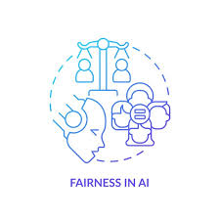
Introduction and Motivation
Software fairness refers to the ethical and unbiased treatment of individuals or groups by software systems.
As technology becomes increasingly integrated into various aspects of society, ensuring fairness in software is essential to mitigate biases, discrimination, and inequality.
The concept of fairness encompasses different dimensions, including racial, gender, socioeconomic, and disability-related fairness, among others.
Decision-making software refers to computer programs or systems designed to analyze information, evaluate options, and make choices, often aiming to support or automate decision-making processes across various domains.
Notes:
Firstly, we need to understand that there are multiple definitions of fairness such as contextual fairness, proportional fairness or distributive fairness to name a few but for this thesis, we will focus on Equality. Equality-based fairness emphasizes on treating all individuals or groups equally, regardless of their differences or circumstances. It aims to ensure that everyone has the same opportunities, rights, and treatment without discrimination or favoritism.
Today, as technology continues to permeate various aspects of our society, from healthcare to finance, education to criminal justice, the ethical and unbiased treatment of individuals or groups by software systems has never been more crucial because we find ourselves at a point where the decisions made by algorithms and artificial intelligence impact our lives in profound ways.
Fairness encompasses various dimensions, including race, gender, socioeconomic, and disability-related fairness, among others. It is about ensuring that the systems that govern our lives treat every individual fairly and justly, regardless of their background or identity.
Decision-making software, in particular, plays a pivotal role in shaping outcomes across diverse domains. Whether it's analyzing data to inform medical diagnoses, evaluating candidates for job opportunities, or predicting recidivism rates in criminal justice systems, these software systems wield immense power in influencing our lives. And unchecked software systems can have adverse implications of biases, discrimination, and inequality that arise from it.
Distributive Fairness: Distributive fairness pertains to the fairness of the outcomes or distributions resulting from a decision or process. It involves ensuring that resources, opportunities, or benefits are allocated in a manner that is perceived as equitable and just by all parties involved.
Proportional Fairness: Proportional fairness considers the proportional contribution or entitlement of individuals or groups to a particular outcome or resource. It aims to ensure that each party receives a fair share relative to their input, effort, or entitlement.
Contextual Fairness: Contextual fairness acknowledges that fairness can vary depending on the context, cultural norms, and societal values. It emphasizes the need to consider the specific circumstances and dynamics of each situation when assessing fairness.

Slide 4
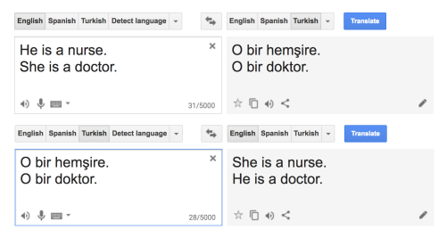


Examples
Google Translate
US Healthcare Needs
Amazon Recruiting Software
Notes:
IThese are just few examples of how fairness was not upheld in the softwares. The first example shows bias in Google Translate that occurred when the system translated gender-neutral pronouns from Turkish to English. In Turkish, the pronoun "o" can refer to both "he" and "she" depending on the context. However, when translated into English, Google Translate consistently rendered "o" as “
“he," reflecting a gender bias.
Reason: This bias stemmed from the fact that the dataset used to train the translation model contained a disproportionate number of examples where "o" was associated with masculine gendered terms. As a result, the translation output exhibited a systemic preference for masculine pronouns, reflecting and perpetuating gender stereotypes. This example underscores the importance of addressing biases in machine learning models and ensuring that translation systems produce fair and inclusive translations across languages and cultures.
For the second example we have bias in Amazon's recruiting system that occurred when the company developed an AI-driven tool to screen job applicants. The system was trained on data from resumes submitted to Amazon over a ten-year period. However, the dataset primarily consisted of resumes from male applicants which reflected a male-dominated tech industry. As a result of this, the AI algorithm learned to favor male candidates over female candidates and the system also downgraded resumes containing certain terms associated with women, such as "women's chess club" or women's college names. This biased algorithm highlighted gender disparities in hiring and raised concerns about fairness.
To understand the third example, there was a study carried out in 2019 published in the journal Science which revealed that an algorithm which was used to predict healthcare needs for over 100 million people exhibited bias against Black patients. This is because the algorithm's methodology relied heavily on past healthcare spending data to forecast future health needs. As Black patients historically received less access to healthcare resources and faced barriers to quality care, their lower healthcare spending was inaccurately interpreted by the algorithm as indicating lower health needs. Consequently, the algorithm systematically underestimated the healthcare needs of Black patients which lead to disparities in resource allocation and healthcare planning.
So, From these examples we come to understand that software bias or discrimination is more prevalent that we think and it could occur in any domain.

Slide 5
State of the Art
Early phases
Later phases
Requirements
Engineering
System
Design
Module
Design
Implementation
Unit
Testing
System Testing and Verification
Detecting discrimination
Mitigating discrimination
Explaining algorithmic decisions
Understanding fairness
Development phase
Literature
Support
Benefits from
Notes:
This image represents the Software Development Lifecycle. We will see how fairness is being tackled in SDLC. As you can see, the first three stages of requirements engineering, system design module design are considered as the early phases whereas implementation, unit testing, system testing and verification are considered as the later phases. To detect discrimination, it can be done starting from the module design phase and can be carried on in the later phases as well.
During the module design phase, the developers carefully analyze the algorithms and decision-making processes implemented within each module and more attention is paid to identifying potential sources of bias and discrimination, such as the selection of features, training data, and decision rules. As the development progresses to implementation, unit testing, and system testing phases, you have various other testing procedures that help evaluate the fairness of the software. This involves conducting tests to identify disparities in outcomes across different demographic groups and assessing the impact of algorithmic decisions on marginalized populations.
Now, There are also approaches to mitigate discrimination and these approached start in the module design phase and can also last in the implementation phase but these approaches do not exist in the testing phases because the goal is to avoid them before we can get to the testing phase.
There are some approaches that are used for explaining algorithmic decisions in general; this usually happens in the unit testing and system testing & verification phase. There is very little work that is being done in the phase that pertains to fairness; for example where they define what fairness means and what are the different fairness measures and so on.
And each of these three things so to say, detecting discrimination, mitigating discrimination and explaining algorithmic decisions could greatly benefit from understanding what fairness constitutes, in detail. And from this image we can also make out that fairness has been overlooked in the first 2 phases. So, my goal for this thesis is to support the specification of fairness requirements in the requirements engineering phase of the software development lifecycle. So, I am not looking to the system design and will focus particularly on the requirements engineering phase.

Slide 6

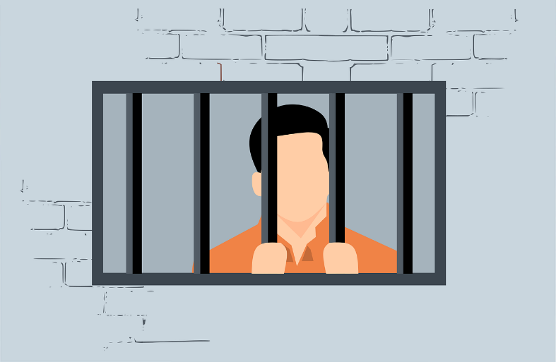
Why should fairness be considered in Requirements Engineering?
To Avoid The Formalism Trap
Example: COMPAS (Correctional Offender Management Profiling for Alternative Sanctions)
COMPAS is a widely used algorithmic tool in the criminal justice system aimed at assessing the risk of reoffending or failing to appear in court among defendants.
COMPAS analyzes various factors such as criminal history, age, employment status, and social environment to generate a risk assessment score.
The purpose of COMPAS is to assist judges and parole boards in making informed decisions about pretrial release, sentencing, and parole supervision
Notes:
So, Let’s move on to why should fairness be considered in requirements engineering?
The answer to this question is to avoid the formalism trap. To understand this, we have the following example.
COMPAS software was a pivotal algorithmic tool that was used in the American criminal justice system, which helps in assessing the risk of reoffending or failing to appear in court among defendants. This algorithmic tool takes into consideration a lot of factors ranging from criminal history and age to employment status to generate a risk assessment score. The overaall goal of this tool is to help the judges in making more informed decisions.

Slide 7
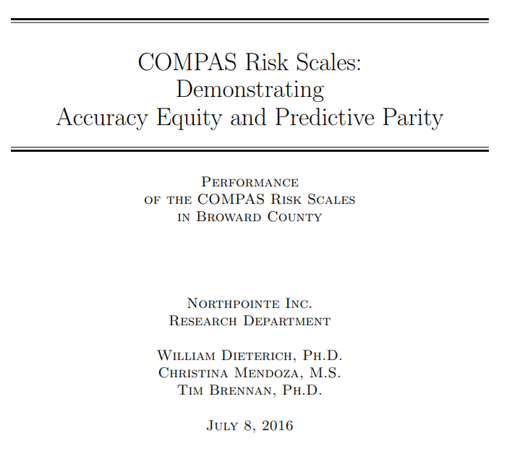
Why should fairness be considered in Requirements Engineering?
ProPublica's investigation shed light on issues of fairness and accountability in the criminal justice system.
COMPAS developers fulfilled their goal of creating a decision-making tool but faced criticism regarding potential biases and lack of transparency.
Consulting legal experts or professionals with domain knowledge before development could have validated requirements and facilitated consensus among stakeholders.
Establishing clear requirements and consensus could have enabled a more transparent and accountable development process, helping to identify and address biases effectively.
COMPAS
Journalists at ProPublica demonstrated that a certain measure of fairness (equality of error rates) was violated.
vs
Notes:
Pro publica conducted an investigation which proved that the compass software violates certain fairness measures such as equality and error rates. They felt people from the marginalized community we're getting higher risk assessment scores compared to others.
Later on, the founder of the compass software came out with a statement stating that the software is fair with respect to accuracy, quality and something els.
This issue occurred due to the lack of clear requirements. If there were clear requirements that were defined then ProPublica could have taken pressed charges against the developers of the compass software for unjust treatment of individuals. Since clear requirements were not specified, both the parties involved were partially right and as they judged the software based on their own requirement, which was not mutually agreed upon.
If the requirements were specified clearly with the consultation of a legal expert who has prior knowledge of this subject, it would have been easier to judge the requirements rather than the software because the software is built on top of the requirements. This way the developers can be very certain that they're developing the right software without having to worry of the legal consequences or redeveloping the software again. Also establishing clear requirements would improve the transparency of the software which will help in identifying and addressing bias more efficiently.

Slide 8
Why is specifying fairness requirements challenging?
The lack of structural conceptual model
Due to the lack of a glossary, there is no standardized definitions for fairness and its related concepts.
No structured framework for understanding fairness concepts.
Increases the risk of misinterpretations and inconsistent application hence leading to ambiguity.
Fairness has multiple interpretations and it is essential to have universally accepted definitions to avoid experts unintentionally working from different perspectives. For example, “Statistical Parity” and “Demographic Parity” can be used interchangeably to describe equal representation among demographic groups.
Notes:
However, specifying fairness requirements can be challenging for 2 reason in particular.
Firstly, one of the primary challenges arises from the lack of a conceptual model. Without a standardized glossary, there absence of universally accepted definitions for fairness and its related concepts. This absence leads to ambiguity which makes it more difficult to establish clear criteria for fairness in software systems.
Additionally, the absence of a structured framework for understanding fairness concepts further adds to this challenge. The lack of a systematic approach makes it challenging to define, and address fairness requirements effectively.
Sometimes, there may be multiple interpretations of fairness to describe the same thing. With various perspectives on what constitutes fairness, non-experts may unintentionally operate from different viewpoints, leading to misinterpretations and inconsistent application

Slide 9

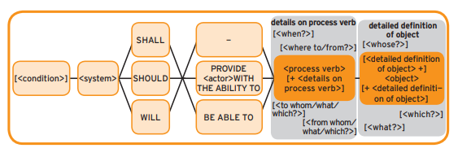
Why is specifying fairness requirements challenging?
The lack of a customized requirements engineering template that allows for specifying fairness requirements.
Requirement 1: The COMPAS software should be able to predict the likelihood of reoffending for individuals.
Requirement 2: The COMPAS software should be designed to ensure fairness by treating all individuals equally
Non-Expert Requirements Engineer
Functional MASTER Template
Notes:
The second reason is the lack of a customized requirements engineering template that allows for specifying fairness requirements
for example, if a non expert requirements engineer is designing functional requirements for a particular software using the functional master template, he or she may define the requirements as shown in these examples.
The first requirement states that the COMPAS software should be able to predict the likelihood of reoffending for individuals. This statement lacks specificity regarding how the prediction should be made and what factors should be considered in the prediction process. Without clear definitions of terms such as "likelihood of reoffending" and "individuals," the requirement becomes ambiguous. Additionally, the requirement does not specify how the accuracy or effectiveness of the prediction should be measured, making it unverifiable.
The second requirement mandates that the COMPAS software should be designed to ensure fairness by treating all individuals equally. While fairness is a considered, the requirement lacks clarity on what constitutes fairness and how it should be achieved. Without clear definitions of fairness and equality, the requirement becomes ambiguous and open to interpretation. Different stakeholders may have different views on what fairness entails, leading to subjective interpretations and potential conflicts and without objective criteria for assessing fairness and equality, it is difficult to determine whether the requirement has been fulfilled.

Slide 10
Research Questions
RQ2: How can the relationships between the identified concepts be effectively expressed and structured in a conceptual model for specifying fairness-related requirements in software?
RQ4: How can the applicability of the developed conceptual model and MASTER template be evaluated through a real-world case study?
RQ3: How can the MASTER template be extended effectively to incorporate explicit fairness conditions in software requirements?
RQ1: What are the fundamental concepts essential for the specification of fairness-related requirements in software development?
Notes:
RQ1: What are the fundamental concepts essential for the specification of fairness-related requirements in software development?
The Objective of this research questions is to identifies the core concepts pertaining to fairness and It aims to delve into the foundational ideas and principles related to specifying fairness-related requirements.. Additionally, this rq will aim to develop a glossary of fairness and its related concepts.
RQ2: How can the relationships between the identified concepts be effectively expressed and structured in a conceptual model for specifying fairness-related requirements in software?
The Objective of this research question is to understand how the identified concepts from RQ1 can be interconnected and expressed in a conceptual model. It will address the challenge of creating a comprehensive framework that can guide the specification of fairness-related requirements in software.
RQ3: How can the MASTER template be extended effectively to incorporate explicit fairness conditions in software requirements?
Objective: Analyze the existing structure and components of the MASTER template to identify potential gaps or limitations in addressing fairness-related requirements. Propose and develop enhancements to the MASTER template, to explicitly address fairness considerations in software requirements specification.
RQ4: How can the applicability of the developed conceptual model and MASTER template be evaluated through a real-world case study?
Objective: Select a diverse and representative real-world case study that involves software development scenarios with potential fairness implications across different domains or contexts. Apply the developed conceptual model and extended MASTER template to the selected case study, ensuring comprehensive coverage of fairness-related requirements and considerations.

Slide 11
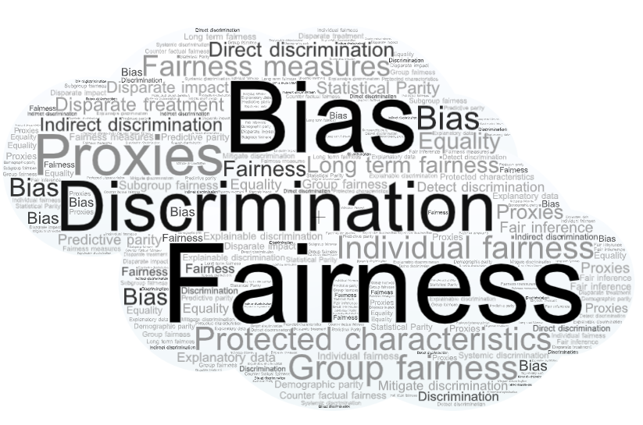
Methodology
RQ1: What are the fundamental concepts essential for the specification of fairness-related requirements in software development?
Methodology:
Systematic Literature Review – Conduct a systematic review of the literature using Mendeley for citation management.
Content Analysis – Analyze literature to extract and compile recurring themes, concepts, and definitions related to fairness in software by using tools such as Microsoft Excel or Google Sheets.
Glossary Development – Synthesis of findings from literature review to develop a glossary of fairness related concepts using tools such as Microsoft Word or Google Docs
Concept | Description
Fairness | The quality of being just, equitable, and unbiased in decision-making processes, ensuring impartial treatment for all individuals.
Type of Fairness | Categorization based on whether the fairness measure addresses group fairness or individual fairness
Protected Attribute | Characteristics, such as gender, age, race, or ethnicity, that are safeguarded against unfair discrimination in algorithmic decision-making
Proxy | An attribute or variable that is used as a substitute for a protected attribute in algorithmic decision-making processes.

Slide 12
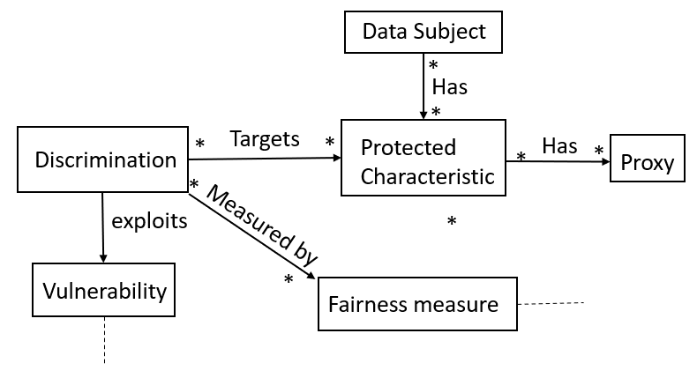
Methodology
Concept | Description
Fairness | The quality of being just, equitable, and unbiased in decision-making processes, ensuring impartial treatment for all individuals.
Type of Fairness | Categorization based on whether the fairness measure addresses group fairness or individual fairness
Protected Attribute | Characteristics, such as gender, age, race, or ethnicity, that are safeguarded against unfair discrimination in algorithmic decision-making
Proxy | An attribute or variable that is used as a substitute for a protected attribute in algorithmic decision-making processes.
RQ2: How can the relationships between the identified concepts be effectively expressed and structured in a conceptual model for specifying fairness-related requirements in software?
Methodology:
Conceptual Mapping – Visualization and mapping of relationships between identified fairness-related concepts using MindMeister.
Model Design – Design a conceptual model based on the mapped relationships and dependencies using draw.io.
Iterative Refinement – Iteratively refine the initial conceptual model.

Slide 13
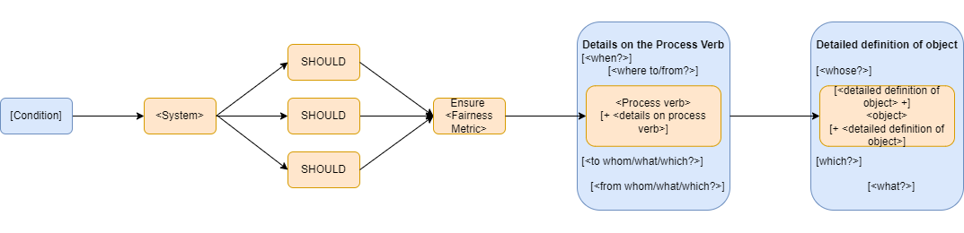
Methodology
RQ3: How can the MASTER template be extended effectively to incorporate explicit fairness conditions in software requirements?
Methodology:
Template Analysis – Analyze the structure and content of the existing MASTER template.
Gap Identification – Identify gaps or deficiencies in the MASTER template concerning the inclusion of fairness-related requirements.
Extension Design – Proposal of modifications or additions to the MASTER template using draw.io.
Extended Master Template

Slide 14
Methodology
RQ4: How can the applicability of the developed MASTER template be evaluated through a real-world case study?
Methodology:
Validation Testing – Testing the conceptual model and extended MASTER template against real-world scenarios and use cases.
Feedback Collection – Gathering feedback from peers and supervisors on the applicability and effectiveness of the conceptual model and extended MASTER template.
Analysis – Analysis of collected feedback to identify strengths, weaknesses, and areas for improvement using tools such as Microsoft Excel or Google Sheets.
Documentation – Document the validation findings and recommendations for future adoption and implementation using tools such as Microsoft Word or Google Docs.
Extended Master Template
Case Studies
Hiring Practices in Tech Companies
Loan Approval Systems in Financial Institutions
Online Advertising Algorithms

Slide 15





Work Packages and Schedule
Week 1-4 | Week 5-8 | Week 9-12 | Week 13-16 | Week 17-20 | Week 21-24
Work Package 1:
Systematic Literature Review & Creating a Glossary
Work Package 2:
Conceptual Model Development
Work Package 3:
Extension of MASTER Template
Work Package 4:
Validation of the requirements template
Work Package 5:
Thesis write-up and documentation

Slide 16
Thank You

